Slide 1
Detection of epileptic seizures using the eeg time series
Mijat Krivokapić SV41/2022

Slide 2
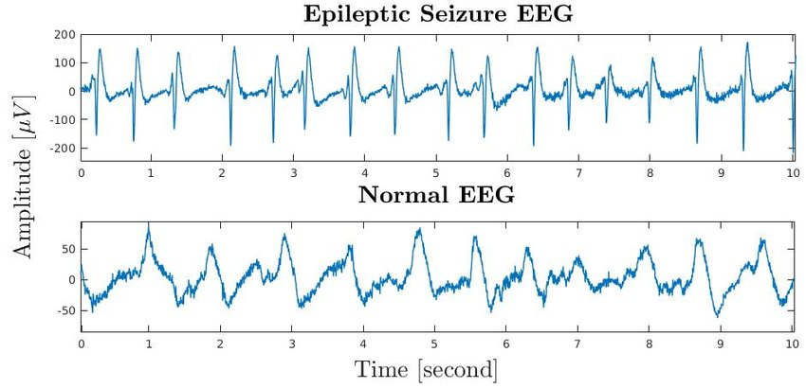
EEG
Electroencephalography is a special neurophysiological method that registers brain electrical activity through electrodes located on the crown of the head or subdurally, inside brain tissue. The resulting diagram is known as an electroencephalogram (EEG). The diagram shows that the EEG at the time of an epileptic seizure differs significantly from a normal EEG. The goal of this project is to create a model that will be able to recognize whether a given EEG time series was recorded during an epileptic seizure.

Slide 3
Dataset and preprocessing
The dataset used to train the model was taken from kaggle.com The dataset contains an EEG time series of 500 people, each lasting 23.6 seconds. Part of the pre-processing has already been done. The original dataset contained 500 files (one for each person), all the data was merged into one csv file. Each row represents one second of the EEG time series, so the file has 500*23=11,500 lines

Slide 4
Dataset and preprocessing
The first column is a label that we can ignore. The next 178 columns represent the values of the EEG signal. The last column (y) represents the following category: 5 - the person's eyes are open 4 - the person's eyes are closed 3 - recording of EEG activity is performed on a healthy part of the brain 2 - Recording of EEG activity is performed in the part of the brain where there is a tumor 1 - The EEG is recorded during an epileptic seizure. For the purposes of this project, it is necessary to consider two cases: Imaging is performed during an epileptic seizure (y=1) Imaging is not performed during an epileptic seizure (y=2,3,4,5)

Slide 5
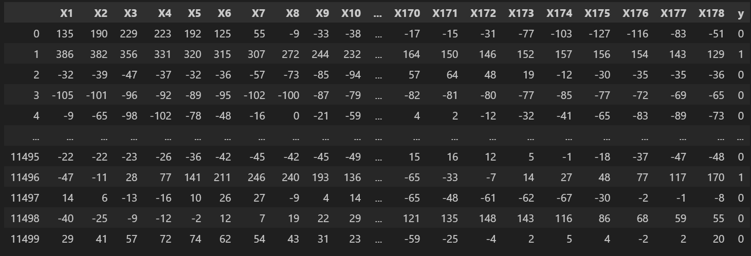
Dataset after pre-processing

Slide 6
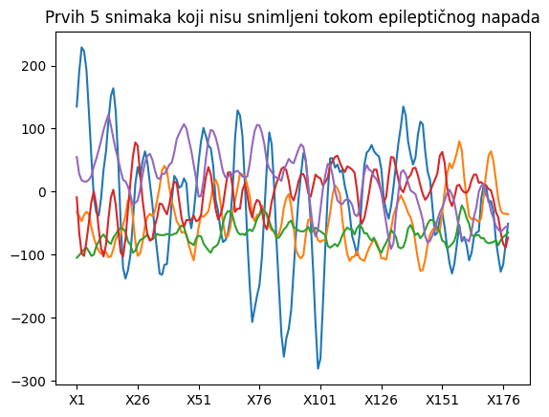
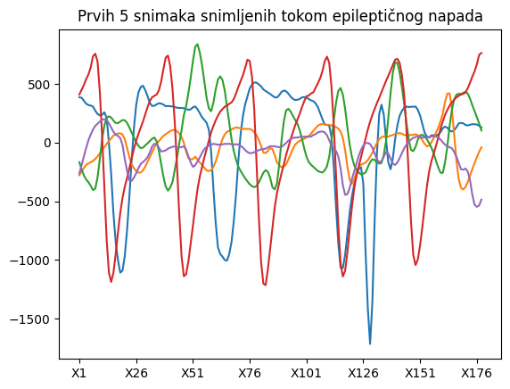
Difference Between Categories in DataSet

Slide 7
Feature extraction
There are many algorithms for feature extraction, in this project will be used: Statistical features, Autoregressive modeling and The Fourier transform.

Slide 8
Classification model
The Support Vector Machine (SVM) will be used for classification. SVM finds the hyperplane that best separates the dots in space that represent the data by creating two classes of points - in this case, those EEG images that were recorded during an epileptic seizure and those that were not. Specifically, the SVC (Support Vectors Classifier) from the scikit-learn library was used. To get the best model, it is necessary to select the appropriate parameter values: Kernel - Specifies the type of hyperplane to be used (linear hyperplane, rbf, poly - nonlinear hyperplane) Gamma - it is needed when using nonlinear hyperplanes, the higher its value, the model tries to fit better into the training data set, which can lead to overfitting. c - penalty parameter for incorrect classification of a point in the training dataset, controls the relationship between the smooth boundary for class decision and the correct classification of training data degree - used when the kernel is set to poly, specifies the degree of the polynomial used to find the hyperplane

Slide 9
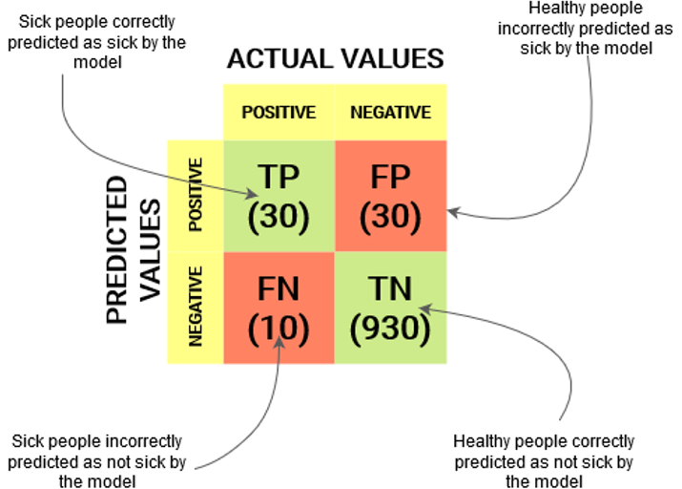
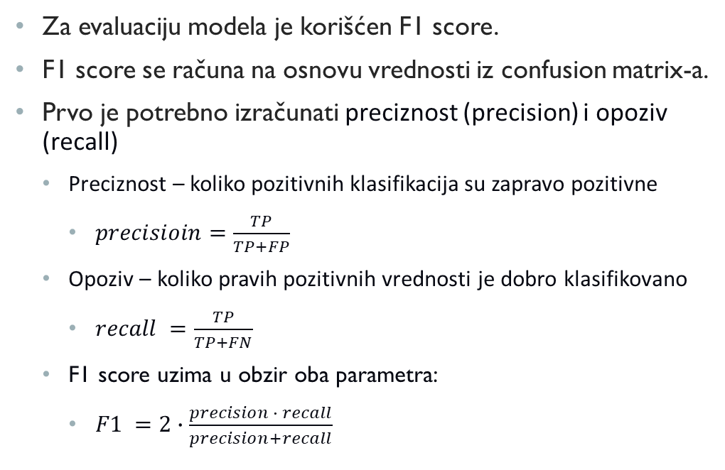
Model Evaluation
The F1 score was used to evaluate the model. The F1 score is calculated based on the value of the confusion matrix. First, you need to calculate the precision and recall. Precision – how many positive classifications are actually positive precisioin=TP/(TP+FP) Recall – how many true positive values are well classified recall =TP/(TP+FN) The F1 score takes into account both parameters: F1 =2∙(precision ∙ recall)/(precision+recall)

Slide 10
Parameter selection
Once we have defined the features, the necessary parameters and the method of evaluating the model, we can move on to the selection of parameters. To select the parameters with the best results, GridSearchCV from the sklearn library was used. It is necessary to define the values that the parameters can have, and GridSearchCV will create a model with each combination of parameter values and compare the quality of the resulting models. Parameter values: c - 0.01, 0.1, 1.0, 10.0, 90, 100.0, 110 gamma 0.001, 0.001, 0.01, 0.1, 1 degree - 2, 3, 4 kernel – linear, rbf, poly

Slide 11
Data scaling
Training an SVC model on unscaled data can be very slow, making it virtually impossible to execute GridSearchCV. During the testing of various parameters, GridSearchCV trains hundreds of models, and it takes several hours to train some of them on unscaled data. A standardscaler is used to scale the data.

Slide 12
Division into training and test dataset
After scaling, the data set is divided into training and test data sets. The split is 80/20. GridSearchCV is invoked over the training data, after which the model with the obtained parameters is evaluated against the test data.

Slide 13
Statistical characteristics
The extraction of statistical properties is reduced to the calculation of the following parameters for each time series: Mean value of the signal Standard deviation The mean absolute value of the first bursts of the signal The mean absolute value of the first differences of the normalized signal The mean absolute value of second signal differences The mean absolute value of second differences of the normalized signal

Slide 14
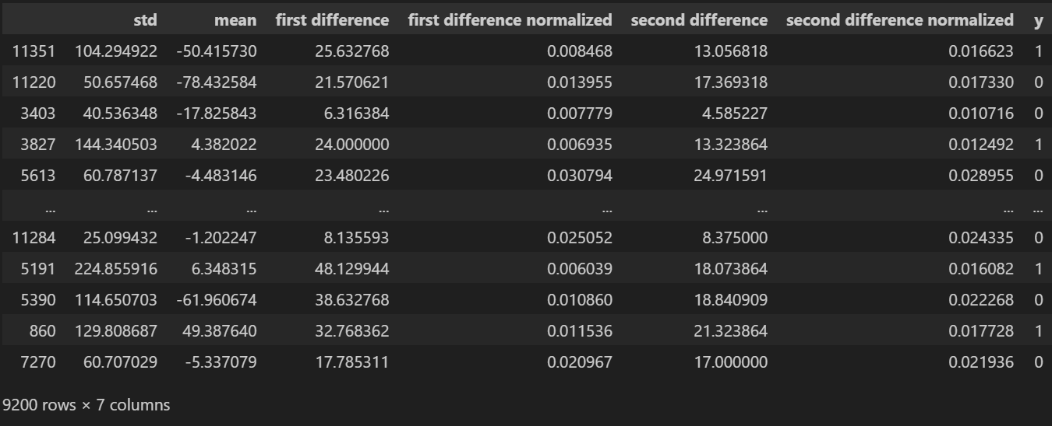
Statistical characteristics

Slide 15
Autoregression model
An autoregression model uses known data to create a linear regression model. In this case, the time series features will be the coefficients of the linear regression equation. Here, the autoregression model is not used to predict values, but to extract properties, which is not its usual purpose. It is also necessary to determine the degree of model that will give the best performance.

Slide 16
Determining the degree of autoregression model
Degree | F1 over test data with default parameters
6 | 0,80
7 | 0,84
8 | 0,87
9 | 0,92
10 | 0,92
11 | 0,92
12 | 0,93
13 | 0,93
14 | 0,92
15 | 0,92
As we see in the table, a significant increase in performance is obtained by the 9th order model, after which performance stagnates. For this reason, the AR model of the 9th order was chosen.

Slide 17
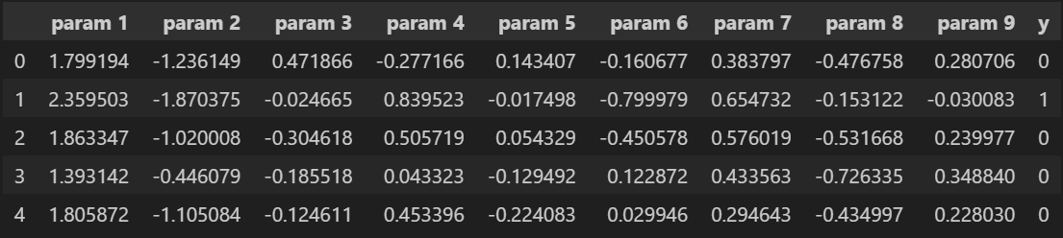
Features obtained by the AR model of the 9th degree

Slide 18
The Fourie transform
The Fourie transform is an approximation of general functions by the sum of simpler trigonometric functions. In the case of an EEG recording, it converts it from a time domain to a frequency domain. This is done using the Fast Fourier Transform (FFT) algorithm. After the FFT algorithm, we get information about the frequencies of the EEG signal and how much each of them contributes to the signal.

Slide 19
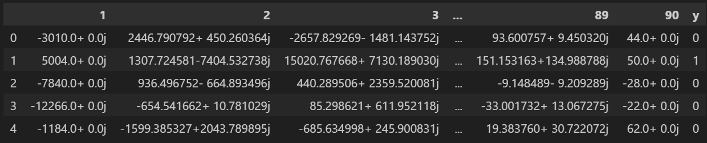
Results of the fft algorithm
The results of the FFT algorithm are complex numbers. Each of the numbers represents the characteristics of one of the frequencies whose sum yields an approximation of the input signal. The amplitude of the frequency was used for the classification, i.e. The absolute value of the FFT algorithm.

Slide 20
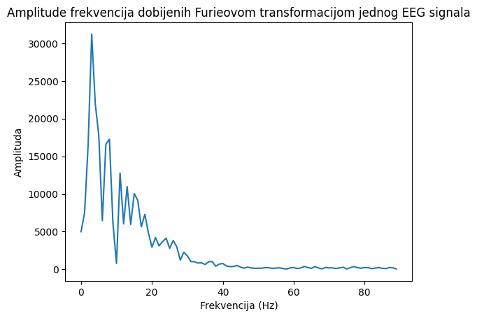
Selecting frequencies
As you can see in the picture, not all frequencies have the same effect on the final signal. That is why we can ignore some of them. For this, we will use the PCA algorithm.

Slide 21
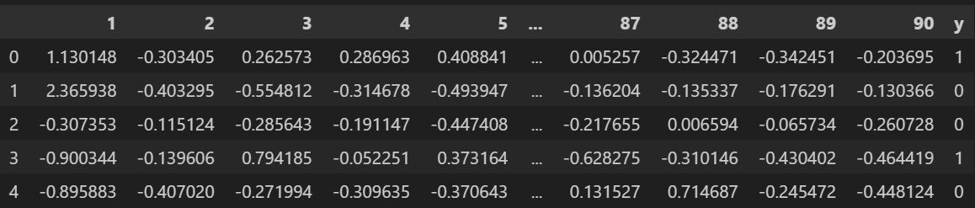
PCA algorithm
First, you need to center and scale the data. The StandardScaler class is used for this.

Slide 22
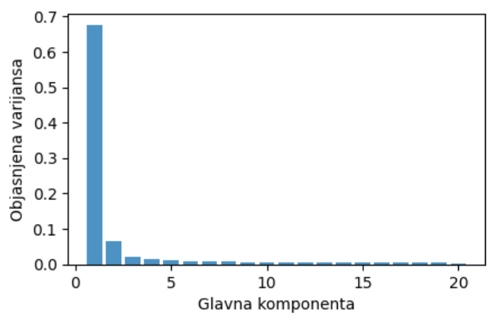
Number of components of the pca algorithm
Initially, the PCA algorithm was developed with 20 components. An overall variance of 86.8% was obtained. On the graph you can see that all components after the 5th are not significant.

Slide 23
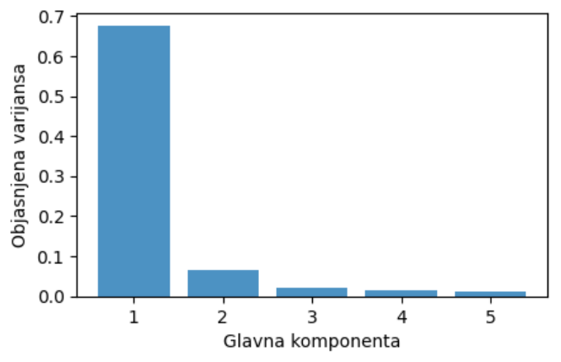
Number of components of the pCA algorithm
For a PCA algorithm with 5 components, a variance of 78.7% is obtained. Perhaps not all 5 components are important to the SVC algorithm, so we will check its performance with a different number of components.

Slide 24
Number of components of the pca algorithm
Number of components | F1 over test data with default parameters
1 | 0,78
2 | 0,93
3 | 0,93
4 | 0,94
5 | 0,95
We can see that the performance after the 2nd component is similar, but due to the simplicity of the model, the search for the best parameters was also performed over 5 components.

Slide 25
Best parameters and results
Osobine | C | Gamma | Kernel | F1
Statistical characteristics | 100 | 0,1 | Rbf | 0,953
AR model | 90 | 0,1 | Rbf | 0,949
The Furie Transform (2 components) | 110 | 0,1 | Rbf | 0,935
The Furie Transform (5 components) | 110 | 0,1 | Rbf | 0,962

Slide 26
Conclusion
Each of the resulting models has satisfactory performance, so each of the feature extraction methods is suitable for detecting epileptic seizures in the EEG time series. The best performance is Furie's transformation with 5 components, it is also a very simple model. The model with the fewest features is the Fourie transform with 2 components, it has the lowest F1 score, but is very close to the performance of the other models.

